Slide 1


Slide 2
I
T
N
U
“Team : Mind Blenders”
Department of Electronics and Communication Engineering,
Institute of Technology, Nirma University
Presented By : Sarthak Farkya 18BEC096
Sanjaykumar Parmar 18BEC069
Ritik Garg 18BEC089

Slide 3
Presentation Outline
Introduction
Snapshots
Features
Block Diagram
Working Demo

Slide 4
Introduction
As we all know that the Digital Era is already started and slowly and gradually we indians also have started to adopt it. Right now from Ordering Gadgets to the Ordering Food we all are Dependent on Technology and In this busy world we want everything on our fingertips to osave the time.
So, Bsially we have created a customised web application using Maps to track the nearby hospitals around us, which will be connected to the hospital's database or manually entered data which will give us the information about the availability of beds and facilities in that particular hospital.

Slide 5
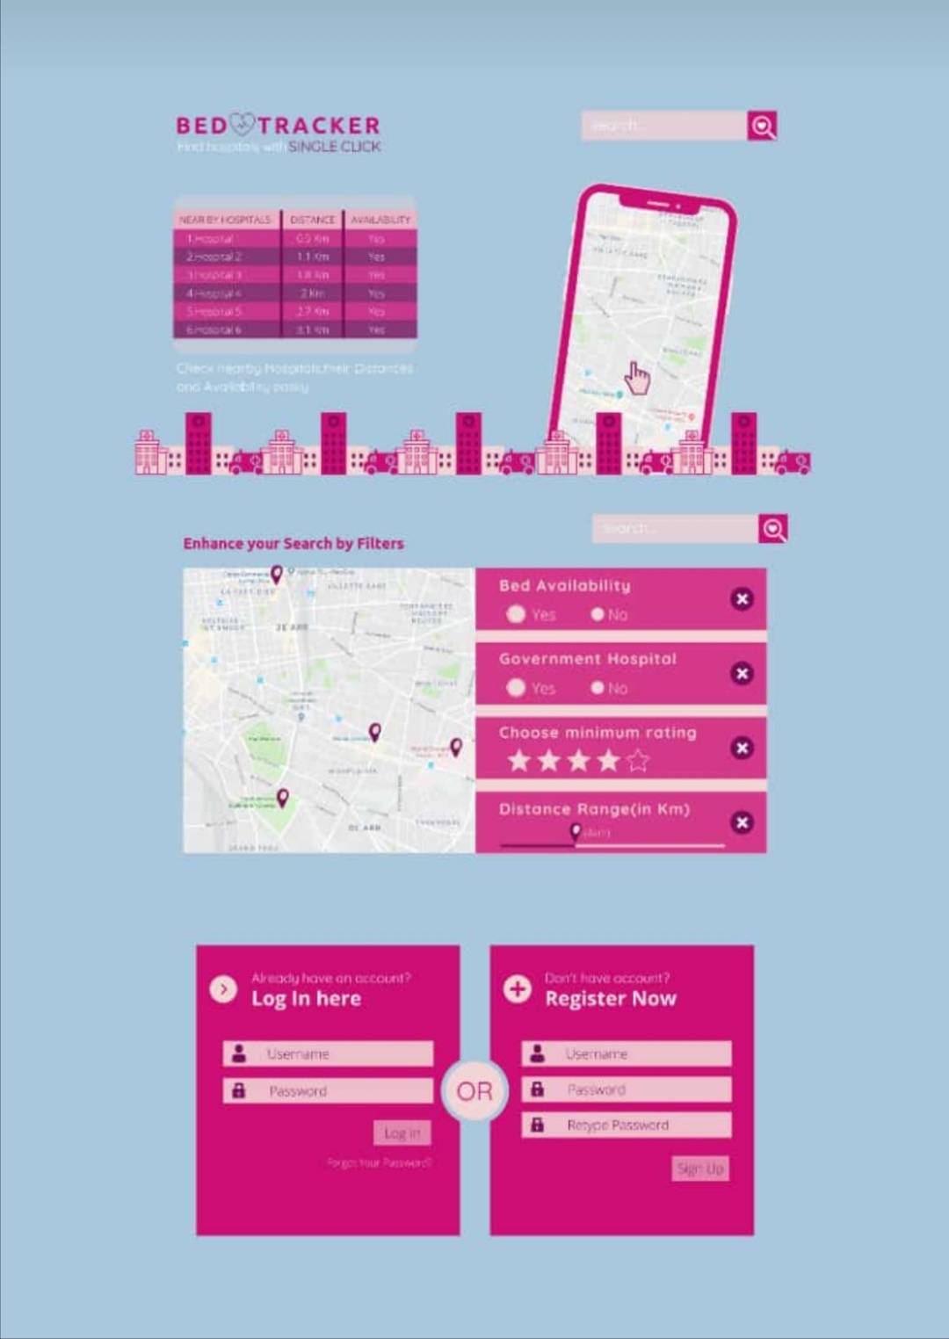
Snapshots

Slide 6
Features
Register
Login
Filter Option
Hospital Name
Hospital Distance from User
Overall Rating
Number of Unoccupied Beds
Number of Total Beds
User can give rating to the Hospital
Hospital data can be directly synchronised with database
Hospital Direction link from user Location

Slide 7
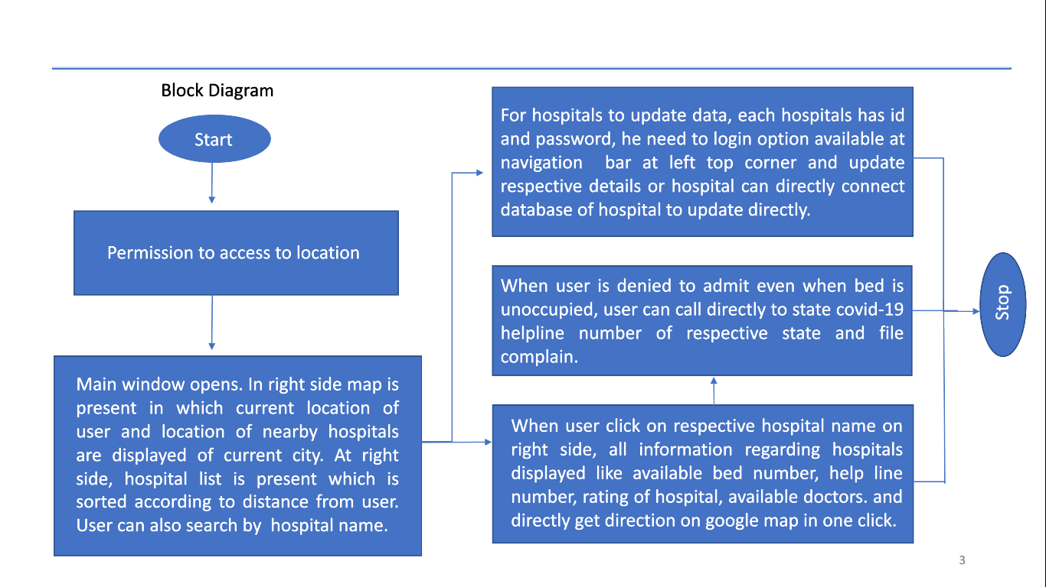

Slide 8
Working Demo

Slide 9
Thank You

